Slide 1
Final Presentation
Project - Bank Analytics
Group - 06

Slide 2
GROUP MEMBERS :-
Pranjali Tembhe
Suryasree Kanchi
Shivani Rayate
Koushik U Bhat
vinay kumar S

Slide 3
Summary
Our project is Bank Analytics, collaboratively developed by our team to transform raw banking data into meaningful business insights.
We used Excel for data cleaning and preprocessing, and MySQL for structured database management.
We built interactive dashboards and visual reports using Power BI and Tableau for real-time analysis.
This project gave us hands-on experience in business intelligence, data visualization, and teamwork while delivering actionable insights.

Slide 4
KPIS LIST
1. Total Loan Amount Funded
2. Total Loans
3. Total Collection
4. Total Interest
5. Branch-Wise Performance
6. State-Wise Loan
7. Religion-Wise Loan
8. Product Group-Wise Loan
9. Disbursement Trend
10. Grade-Wise Loan
11. Default Loan Count
12. Delinquent Client Count
13. Delinquent Loan Rate
14. Default Loan Rate
15. Loan Status-Wise Laan
16. Age Group-Wise Loan
17. Loan Maturity.
18. No Verified Loans

Slide 5
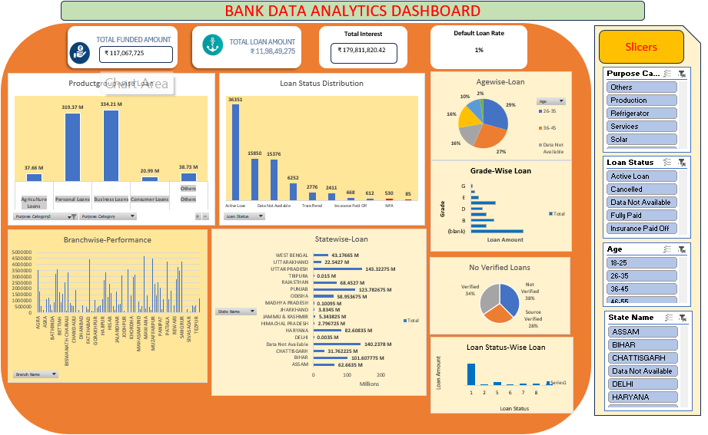
EXCEL DASHBOARD
KEY INSIGHTS OF DASHBOARD
Collected and organized banking data efficiently using Excel.
Performed data cleaning and preprocessing for accurate analysis.
Used filters, sorting, and formulas to manage large datasets easily.
Created interactive charts and graphs for better data visualization.
Improved understanding of customer and banking trends through reports.

Slide 6
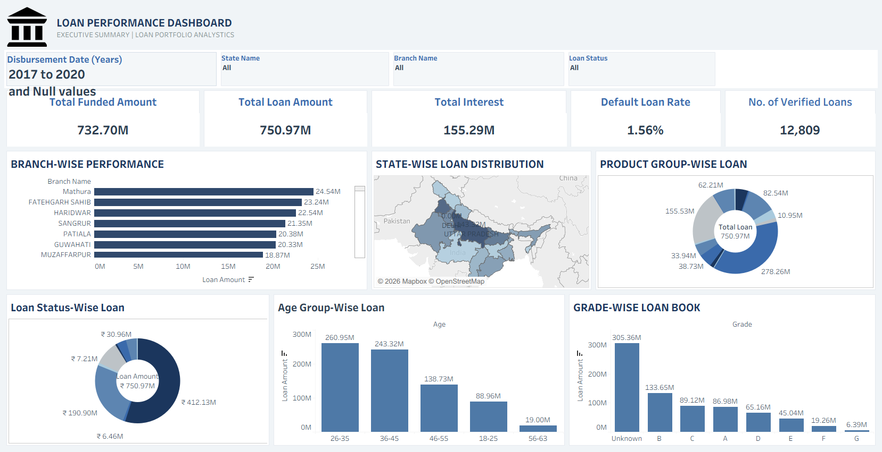
TABLEAU DASHBOARD
KEY INSIGHTS OF DASHBOARD
Created interactive and visually appealing dashboards using Tableau.
Analyzed banking data through charts, graphs, and filters for better insights.
Converted complex data into simple and understandable visual reports.
Improved decision-making by identifying trends and performance patterns.
Used dynamic visualizations to enhance user interaction and analysis.

Slide 7
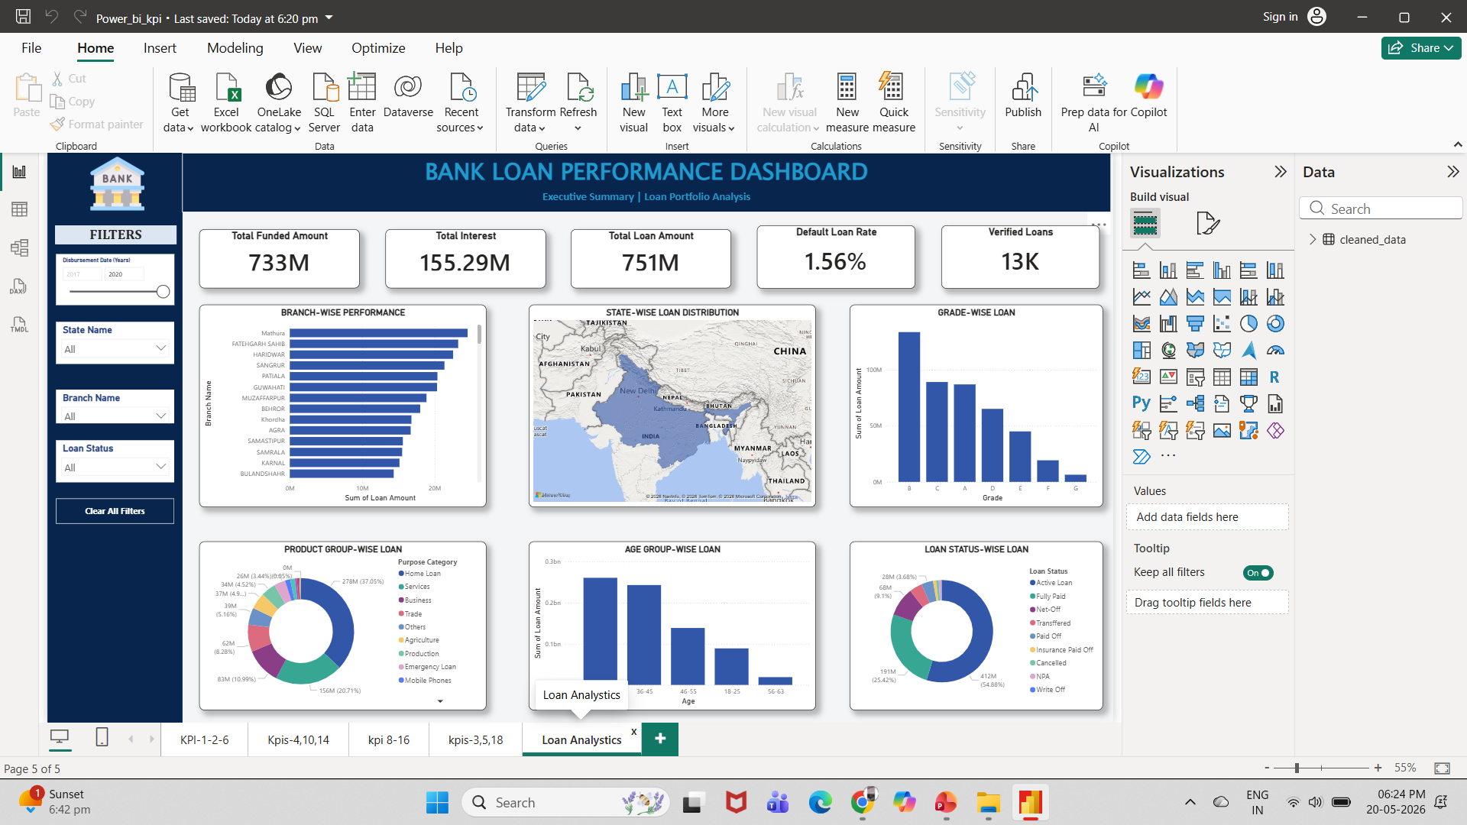
POWER-BI DASHBOARD
KEY INSIGHTS OF DASHBOARD
Developed interactive dashboards using Microsoft Power BI for banking data analysis.
Created clear and meaningful visual reports using charts, KPIs, and graphs.
Performed data transformation and analysis for better business insights.
Improved decision-making through real-time data visualization.

Slide 8
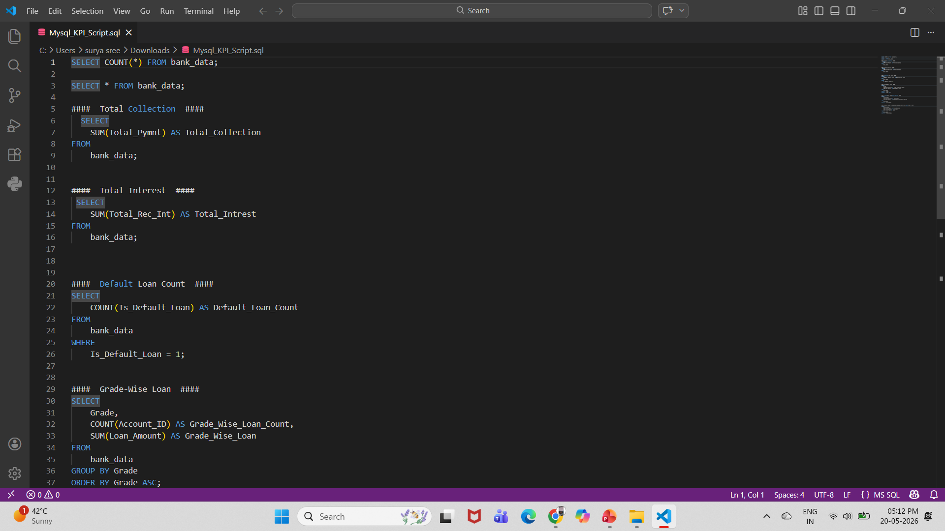
MY-SQL QUERY
KEY INSIGHTS OF SQL QUERY
Managed and organized banking data efficiently using MySQL.
Used SQL queries to retrieve, filter, and analyze large datasets.
Performed operations like SELECT, WHERE, GROUP BY, and JOIN for data analysis.
Improved accuracy and speed in handling banking records and transactions.
Extracted meaningful insights from raw data using query-based analysis.

Slide 9
KEY TAKEAWAY POINTS
📊 Data Analytics Experience
Gained practical knowledge in analyzing real-time banking data.
Understood how data helps organizations make smarter business decisions.
🛠️ Technical Skills Developed
Worked with Excel for data cleaning and preprocessing.
Used MySQL for data storage and query handling.
Built interactive dashboards using Microsoft Power BI and Tableau.
📈 Visualization & Insights
Converted raw banking data into clear and meaningful visual reports.
Improved understanding of trends, performance analysis, and business insights.
🤝 Team Collaboration
Enhanced teamwork, communication, and project management skills.
Learned how collaborative efforts improve project quality and outcomes.

Slide 10
THANK YOU

